Slide 1
Locker Automation System
“ ”
A Golden Phoenicks ™ CENG355 Capstone Project

Slide 2
Chapter 1: Humble Beginnings
The problem solved by this project is ease of access to a locker. Access to lockers can be difficult for student with many items to carry, or those with disabilities. Currently almost all lockers are manually operated and therefore not accessible by anyone with a severe physical disability..
Hopefully, if the project is a success, future students could then have the ability to access their locker from any given location from their secure application downloadable from google play.

Slide 3
Chapter 2: “A Box of Scraps”
Raspberry Pi 3B
Talentcell 12V 3000mAh Lithium Ion Battery Pack
Adafruit 12VDC Lock-Style Solenoid
Globe Motors 12V DC Gear Motor
Hitachi HD44780 16x2 LCD Display
Custom GoldenPhoenicks Control PCB
Dual Channel L9110 H-Bridge Motor Driver Board
Iron Rod
Wires + Cables
Acrylic (Optional)
Magnets (Optional)

Slide 4
Chapter 3: Money Talks
Results fetched from Amazon.ca (CAD)
and A1 Electronics.
Raspberry Pi 3B - $90
Talentcell 12V 3000mAh Lithium Ion Battery Pack- $ 38.99
Adafruit 12VDC Lock-Style Solenoid- $11
Globe Motors 12V DC Gear Motor - $14
Hitachi HD44780 16x2 LCD Display - $5
Dual Channel L9110 H-Bridge Motor Driver Board $6
Wires + Cables ~ $30
Headers + pins - $30

Slide 5
Chapter 4: The Flow of Time
Weeks 1-4: Documentation
Week 5: Integration brainstorming
Week 6: PCB design and code integration begins
Week 7: PCB redesign
Week 8: PCB redesign (again)
Week 9 and 10: Documentation
Week 11: Full hardware prototype integrated into locker (toolkit for the purposes of prototype)

Slide 6
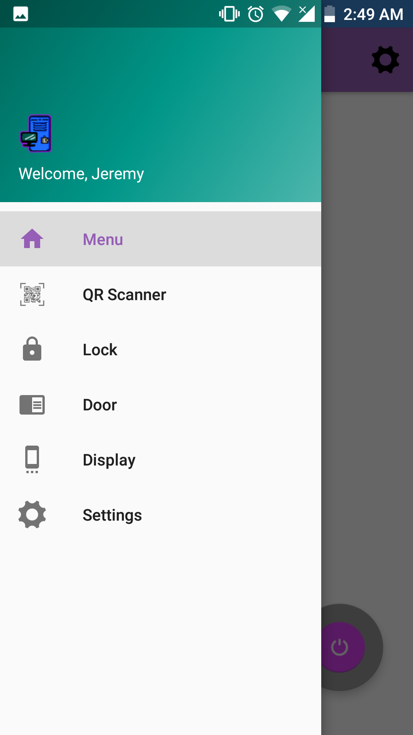
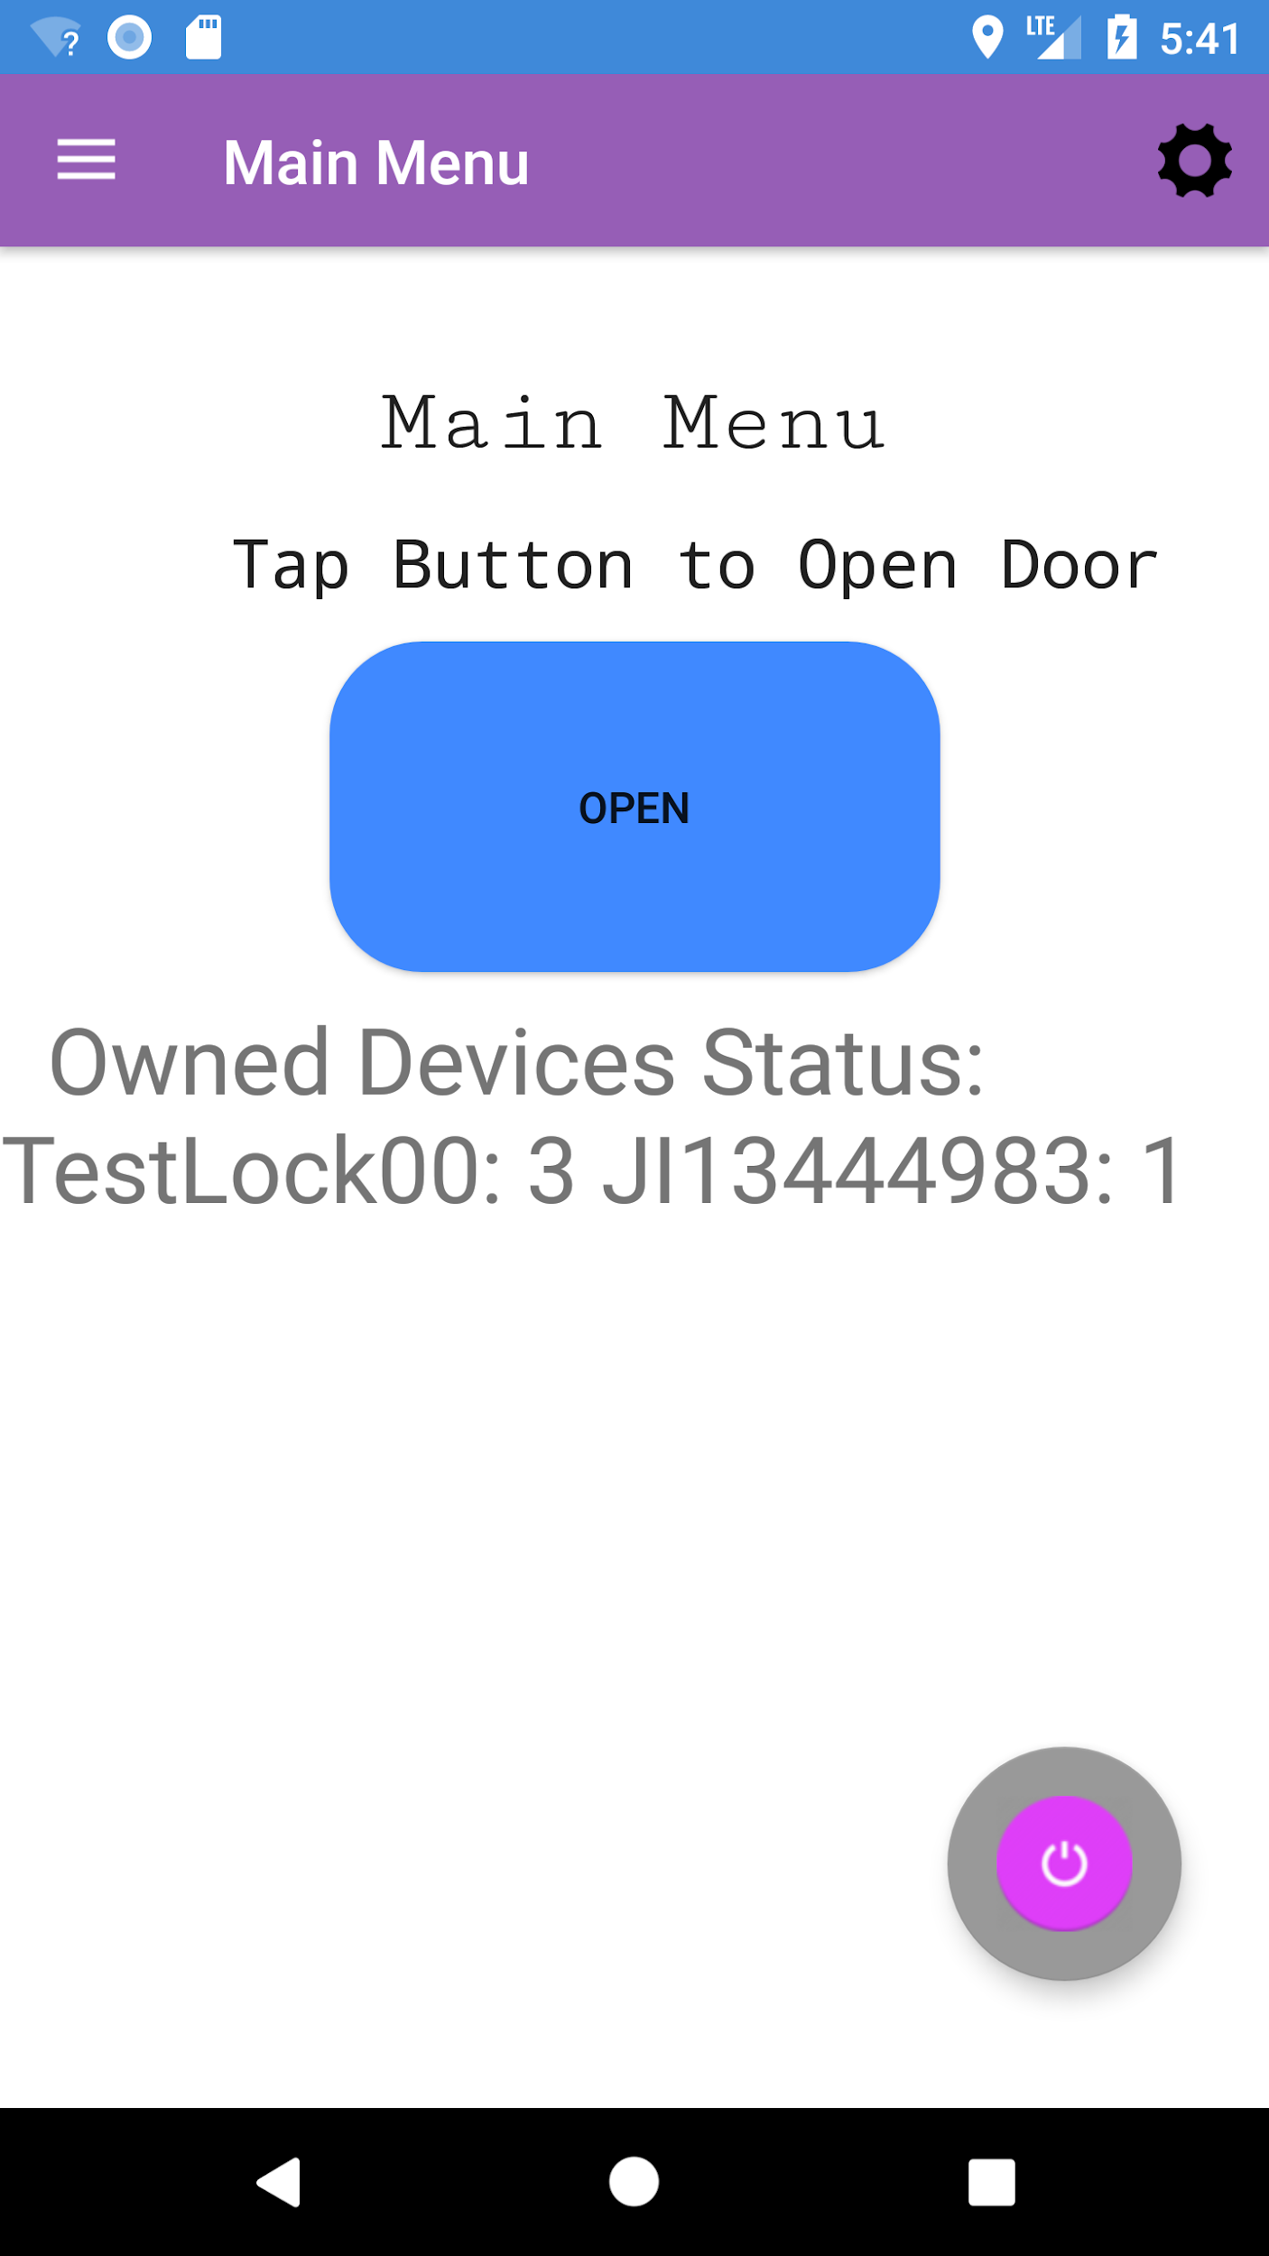
Chapter 5: Reduce Reuse Recycle
The application made to meet the requirements of CENG318 remain largely unchanged in functionality and aesthetic.
To provide a simpler user experience, the separate activities for Door, Lock and Display have all been merged and placed on the Main Activity upon logging in.

Slide 7
Chapter 5, continued...
The only change made was the removal of the Solenoid Driver Board which came to be as a result of fully integrating our Solenoid Lock with the driver board that powered the DC Motor project from last year.
Otherwise, no changes in hardware were made. Due to the transistor driver board encountering technical issues however, a new one of the same make and model was ordered.

Slide 8
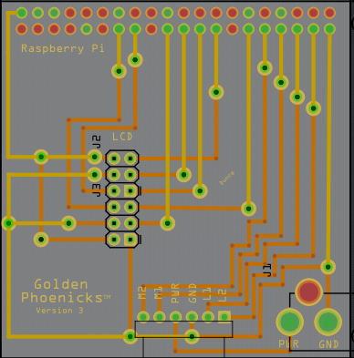
Chapter 6: Collision

Slide 9
Chapter 6: Collision Continued...
To allow the full integration with the existing Android application and MySQL Database, a new PHP script was written that returns the product statuses which is then called by a Python script in the Raspberry Pi itself. Using this data, the Python script calls the necessary functions based on the functions already written for CENG317’s demonstration.

Slide 10

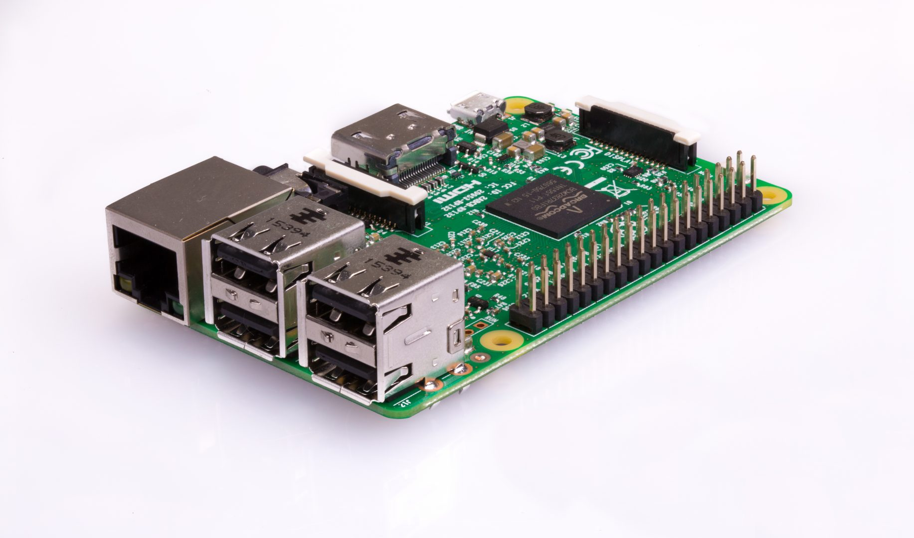
Chapter 6: Collision Continued...
Below is a diagram that illustrates how the 3 interact.
MySQL Database + PHP
Raspberry Pi (Python)
Android Application

Slide 11
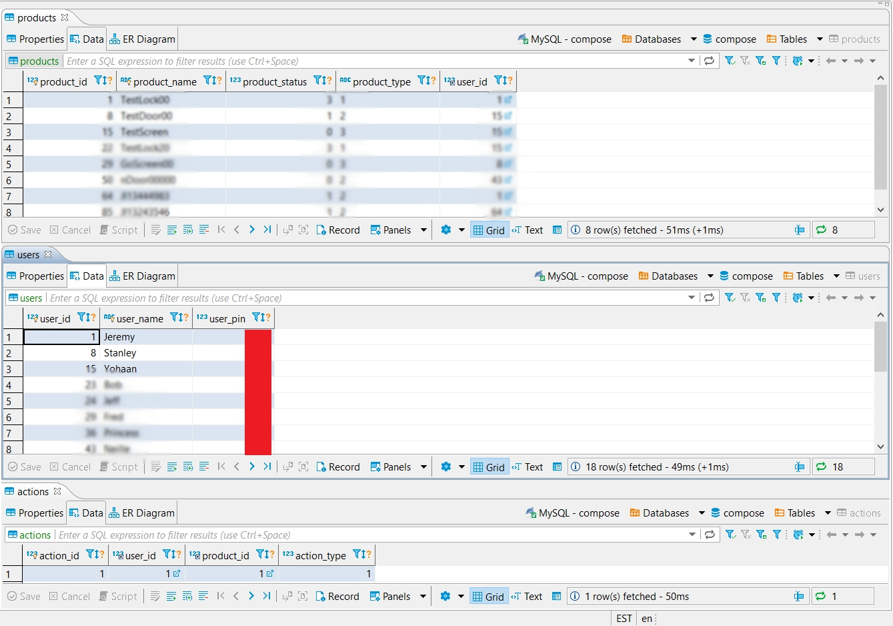

Chapter 6.5: On Cloud 9...

Slide 12
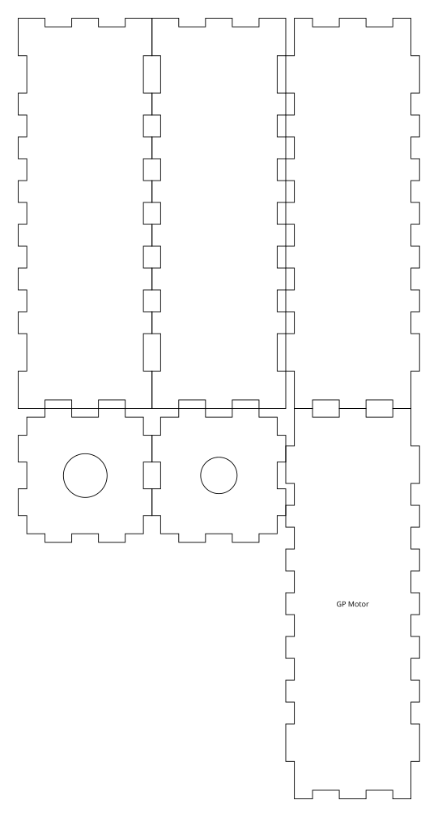
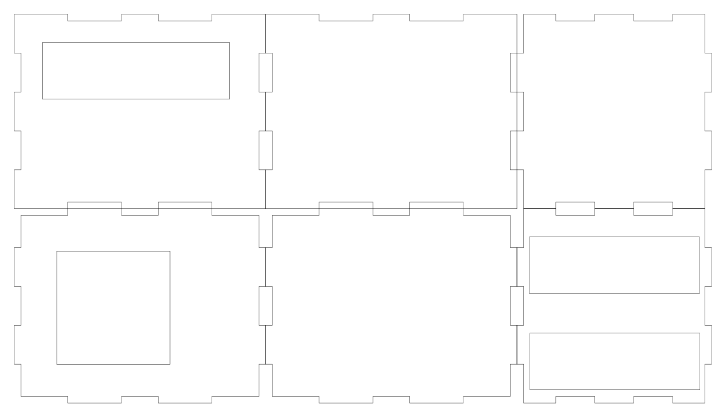
Chapter 7: Protection.
Laser cut designs

Slide 13

Chapter 8: It’s Show Time

Slide 14
Chapter 9: A Look Into the Past
Electronic Circuits and Hardware
TECH101
TECH150
CENG215
CENG252
CENG317
Programming and Java Development
TECH104
TECH153
CENG212
CENG318
Database Handling and Script Commands
CENG254
CENG256
CENG200
CENG320

Slide 15
Chapter 10: A Dream to Come
In the future, if we were to commercialize the devices, we would need to make the following modifications:
Modify the register new account feature to create temporary dummy product names tied to their account
Fix minor bugs in the Android application
Pair a product with its product code
Cable management

Slide 16
Fini ~

